Slide 1
AMAZON SALES ANALYSIS

Slide 2
INTRODUCTION
Welcome to my Amazon Sales Analysis report
We'll explore how products are performing on Amazon, helping businesses make better decisions. By examining sales trends, customer behavior, and product performance, we aim to provide insights that boost sales and profitability.
Amazon sales analysis looks at how well things sell on Amazon. It helps businesses understand what's popular and why. By looking at things like what sells the most and what customers say, companies can make smarter choices. This helps them sell more and make more money.

Slide 3
PROBLEM STATEMENT
Sales management has gained importance to meet increasing competition and the need for improved methods of distribution to reduce cost and to increase profits. Sales management today is the most important function in a commercial and business enterprise.

Slide 4
HOW I STARTED THIS PROJECT?
1. Get Your Data: Firstly, I collected my Amazon sales data. This can include information like sales revenue, product details, customer feedback, etc.
2. Open Power BI Desktop: I downloaded Power BI Desktop on my laptop.
3. Connect to Data: I clicked on "Get Data" and selected my data source ( Excel file). Chose my Amazon sales data file and loaded it into Power BI.
4. Transform Data: Then I used Power BI's data transformation tools to clean and organize my data. This might involve renaming columns, removing duplicates, or formatting data types.
5. Create Visualizations: I designed my dashboard by adding visualizations such as charts, graphs, and tables.

Slide 5
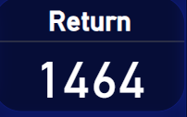
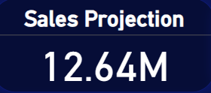
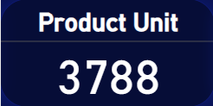
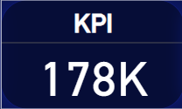
KEY INSIGHTS

Slide 6
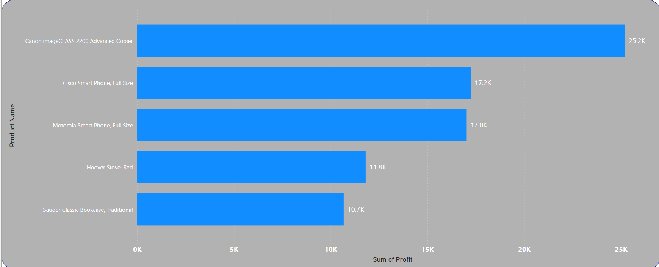
TOP 5 PROFIT BY PRODUCT

Slide 7
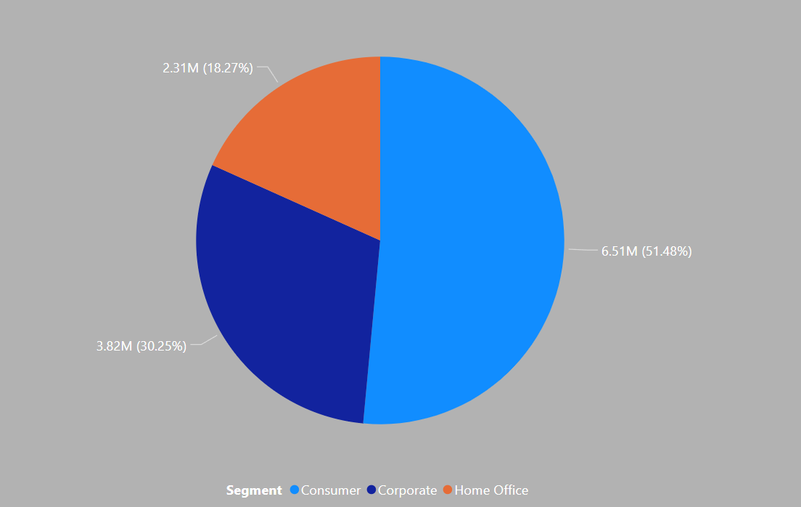
SALES BY SEGMENT

Slide 8
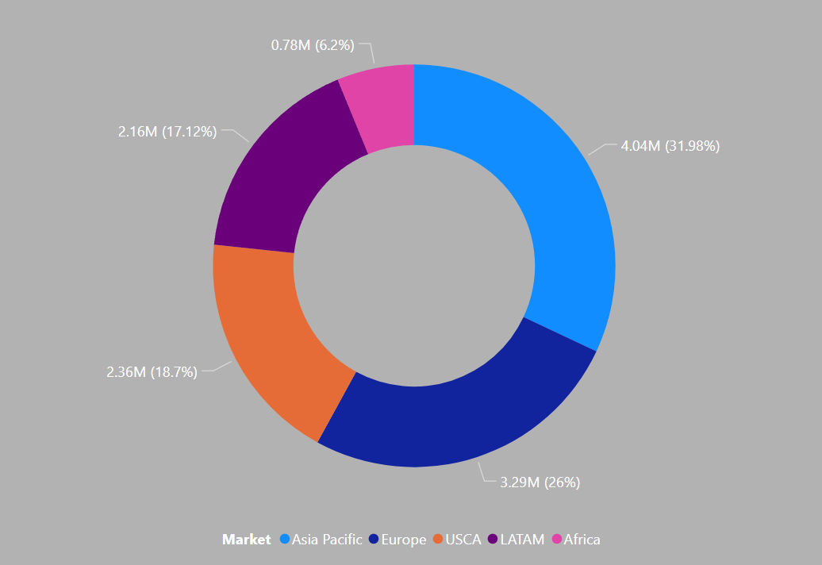
SALES BY MARKET

Slide 9
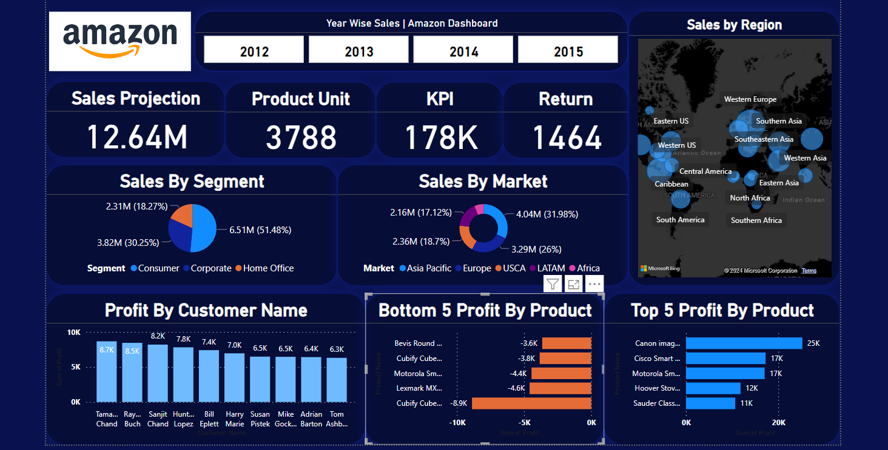
MY AMAZON DASHBOARD

Slide 10
~THANK-YOU

